Slide 1
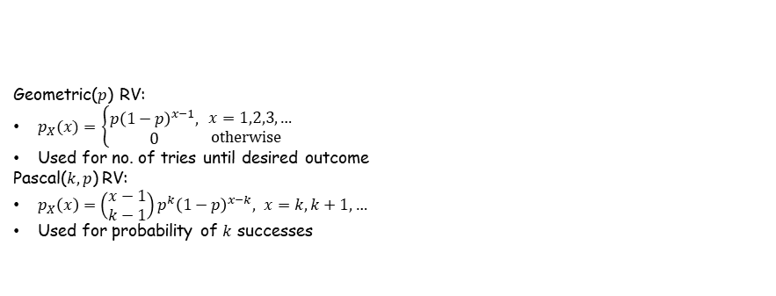
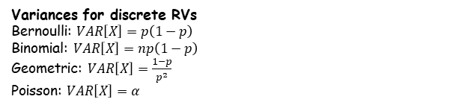

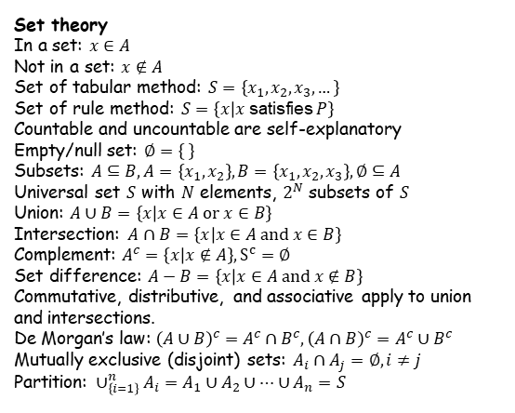


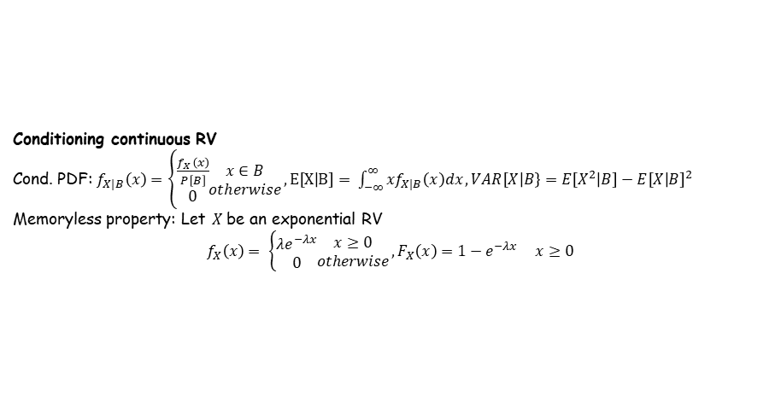

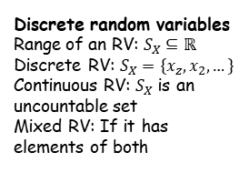

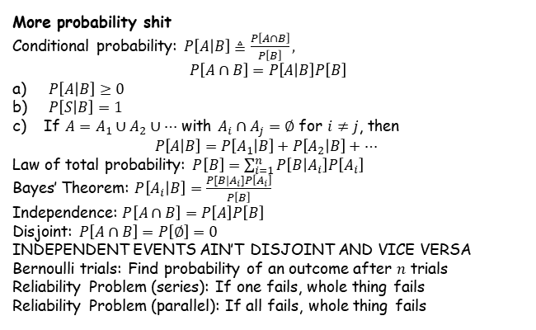
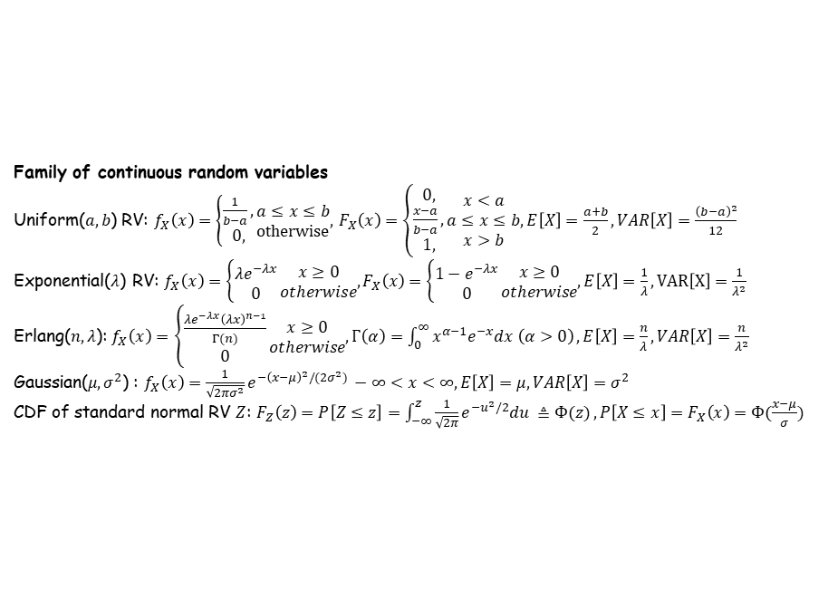
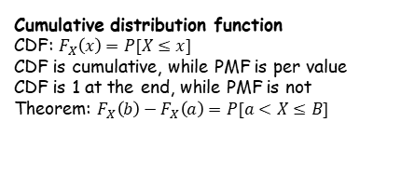
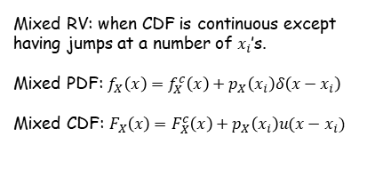
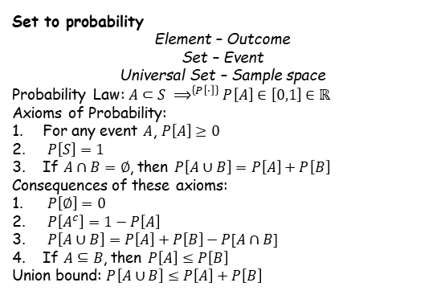
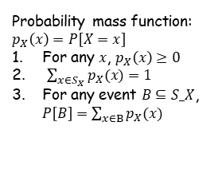
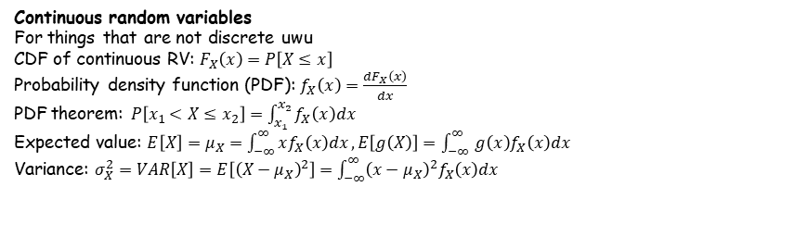
Probability
The chance something happens
We use models to represent a system
Types of models:
Deterministic: Outcome is determined by input conditions
Probabilistic/Stochastic: Outcome can vary; degree of randomness
Building a model:
Define the random experiment inherent in the problem,
Specify the set of all possible outcomes and events of interest,
Specify a probability assignment for the outcomes and events.
Family of discrete random variables
Bernoulli($p$) RV:
$p_{X}\left(x\right)=\left\{\begin{aligned}1−p, \\ p, \\ 0, \end{aligned}\begin{matrix}x=0 \\ x=1 \\ \text{otherwise}\end{matrix}\right.$
Used for experiments with 2 outcomes
Binomial($n,p)$ RV:
$p_{X}(x)=\left\{\begin{aligned}\left({n \atop x}\right)p^{x}{\left(1−p\right)}^{n−x}, \\ 0,\end{aligned}\right.\begin{matrix}x=0,1,2,…,n \\ \text{otherwise}\end{matrix}$
Used in exp. with $n$ trials of 2 outcomes
Poisson($α$) RV:
$p_{X}\left(x\right)=\left\{\begin{aligned}\frac{α^{x}e^{−a}}{x!}, \\ 0,\end{aligned}\begin{matrix} x=0,1,2,… \\ \text{otherwise}\end{matrix}\right.$, $α=λT$
Used for number of completely random events
Geometric($p$) RV:
$p_{X}(x)=$ $\left\{\begin{aligned}p{\left(1−p\right)}^{x−1}, \\ 0\end{aligned}\right.\begin{matrix} x=1,2,3,… \\ \text{otherwise}\end{matrix}$
Used for no. of tries until desired outcome
Pascal($k,p$) RV:
$p_{X}\left(x\right)=\left(\begin{matrix}x−1 \\ k−1\end{matrix}\right)p^{k}{\left(1−p\right)}^{x−k}, x=k,k+1,…$
Used for probability of $k$ successes
Expected Value
Expected value: $E\left[X\right]=μ_{X}=∑xp_{X}\left(x\right)$
Bernoulli: $E\left[X\right]=p$
Binomial: $E\left[X\right]=np$
Geometric: $E\left[X\right]=\frac{1}{p}$
Poisson: $E\left[X\right]=α$
Set theory
In a set: $x∈A$
Not in a set: $x∉A$
Set of tabular method: $S=\left\{x_{1},x_{2},x_{3},…\right\}$
Set of rule method: $S=\left\{x | x \text{satisfies} P\right\}$
Countable and uncountable are self-explanatory
Empty/null set: $∅=\left\{ \right\}$
Subsets: $A⊆B, A=\left\{x_{1},x_{2}\right\},B=\left\{x_{1},x_{2},x_{3}\right\},∅⊆A$
Universal set $S$ with $N$ elements, $2^{N}$ subsets of $S$
Union: $A∪B=\left\{x | x∈A \text{or} x∈B\right\}$
Intersection: $A∩B=\left\{x | x∈A \text{and} x∈B\right\}$
Complement: $A^{c}=\left\{x | x∉A\right\}, S^{c}=∅$
Set difference: $A−B=\left\{x | x∈A \text{and} x∉B\right\}$
Commutative, distributive, and associative apply to union and intersections.
De Morgan’s law: ${\left(A∪B\right)}^{c}=A^{c}∩B^{c},{\left(A∩B\right)}^{c}=A^{c}∪B^{c}$
Mutually exclusive (disjoint) sets: $A_{i}∩A_{j}=∅,i≠j$
Partition: $∪_{\left\{i=1\right\}}^{n}A_{i}=A_{1}∪A_{2}∪…∪A_{n}=S$
Cumulative distribution function
CDF: $F_{X}\left(x\right)=P[X≤x]$
CDF is cumulative, while PMF is per value
CDF is 1 at the end, while PMF is not
Theorem: $F_{X}\left(b\right)−F_{X}\left(a\right)=P[a<X≤B]$
Variances for discrete RVs
Bernoulli: $VAR\left[X\right]=p\left(1−p\right)$
Binomial: $VAR\left[X\right]=np\left(1−p\right)$
Geometric: $VAR\left[X\right]=\frac{1−p}{p^{2}}$
Poisson: $VAR\left[X\right]=α$
Function of RV
Function: $Y=g\left(X\right)$
For discrete, PMF is: $p_{Y}\left(y\right)=\sum_{\left\{x | g\left(x\right)=y\right\}}{p_{X}(x)}$
Expected value of Y: $μ_{Y}=E\left[Y\right]=E\left[g\left(x\right)\right]=\sum_{x∈S_{X}}{g\left(x\right)p_{X}(x)}$
Linear func of RV: $E\left[aX+b\right]=aE\left[X\right]+b$
Variance: $VAR\left[X\right]=σ_{X}^{2}≜E\left[{\left(X−μ_{X}\right)}^{2}\right]=\sum_{x∈S_{X}}{{\left(x−μ_{X}\right)}^{2}p_{X}\left(x\right)}$
Also variance: $VAR\left[X\right]=E\left[X^{2}\right]−{\left(E\left[X\right]\right)}^{2}$
Also variance ffs: $VAR\left[aX+b\right]=a^{2}VAR\left[X\right]$ $∈S_X$
Conditional PMF: $p_{X|B}\left(x\right)=P\left[X=x | B\right]$
Continuous random variables
For things that are not discrete uwu
CDF of continuous RV: $F_{X}\left(x\right)=P\left[X≤x\right]$
Probability density function (PDF): $f_{X}\left(x\right)=\frac{dF_{X}\left(x\right)}{dx}$
PDF theorem: $P\left[x_{1}<X≤x_{2}\right]=\int_{x_{1}}^{x_{2}}{f_{X}\left(x\right)dx}$
Expected value: $E\left[X\right]=μ_{X}=\int_{−∞}^{∞}{xf_{X}\left(x\right)dx}, E\left[g\left(X\right)\right]=\int_{−∞ }^{∞}{g\left(x\right)f_{X}\left(x\right)dx}$
Variance: $σ_{X}^{2}=VAR\left[X\right]=E\left[{\left(X−μ_{X}\right)}^{2}\right]=\int_{−∞}^{∞}{{\left(x−μ_{X}\right)}^{2}f_{X}\left(x\right)dx}$
Set to probability
Element – Outcome
Set – Event
Universal Set – Sample space
Probability Law: $A⊂S ⟹^{\left\{P\left[⋅\right]\right\}}P\left[A\right]∈\left[0,1\right]∈ℝ$
Axioms of Probability:
For any event $A$, $P\left[A\right]≥0$
$P\left[S\right]=1$
If $A∩B=∅$, then $P\left[A∪B\right]=P\left[A\right]+P\left[B\right]$
Consequences of these axioms:
$P\left[∅\right]=0$
$P\left[A^{c}\right]=1−P\left[A\right]$
$P\left[A∪B\right]=P\left[A\right]+P\left[B\right]−P[A∩B]$
If $A⊆B$, then $P\left[A\right]≤P\left[B\right]$
Union bound: $P\left[A∪B\right]≤P\left[A\right]+P\left[B\right]$
Validity of a PDF: $f_{X}\left(x\right)≥0$ and $\int_{−∞}^{∞}{f_{X}\left(x\right)}=1$
Family of continuous random variables
Uniform($a,b$) RV: $f_{X}\left(x\right)=\left\{\begin{aligned}\frac{1}{b−a}, \\ 0,\end{aligned}\right.\begin{matrix}a≤x≤b \\ \text{otherwise}\end{matrix},$ $F_{X}\left(x\right)=\left\{\begin{aligned}0, \\ \frac{x−a}{b−a}, \\ 1,\end{aligned}\right.\begin{matrix}x<a \\ a≤x≤b \\ x>b\end{matrix}, E\left[X\right]=\frac{a+b}{2}, VAR\left[X\right]=\frac{{\left(b−a\right)}^{2}}{12}$
Exponential($λ$) RV: $f_{X}\left(x\right)=\left\{\begin{aligned}λe^{−λx} \\ 0\end{aligned}\right.\begin{matrix}x≥0 \\ otherwise\end{matrix}, F_{X}\left(x\right)=$ $\left\{\begin{aligned}1−e^{−λx} \\ 0\end{aligned}\right.\begin{matrix}x≥0 \\ otherwise\end{matrix}, E\left[X\right]=\frac{1}{λ}, VAR\left[X\right]=\frac{1}{λ^{2}}$
Erlang($n,λ$): $f_{X}\left(x\right)=\left\{\begin{aligned}\frac{λe^{−λx}{\left(λx\right)}^{n−1}}{Γ(n)} \\ 0\end{aligned}\right.\begin{matrix}x≥0 \\ otherwise\end{matrix}, Γ\left(α\right)=\int_{0}^{∞}{x^{α−1}e^{−x}dx \left(α>0\right)}, E\left[X\right]=\frac{n}{λ}, VAR\left[X\right]=\frac{n}{λ^{2}}$
Gaussian($μ,σ^{2}$) : $f_{X}\left(x\right)=\frac{1}{\sqrt{2πσ^{2}}}e^{−{\left(x−μ\right)}^{2}/(2σ^{2})} −∞<x<∞, E\left[X\right]=μ, VAR\left[X\right]=σ^{2}$
CDF of standard normal RV $Z$: $F_{Z}\left(z\right)=P\left[Z≤z\right]=\int_{−∞}^{z}{\frac{1}{\sqrt{2π}}e^{−u^{2}/2}du ≜Φ(z)}, P\left[X≤x\right]=F_{X}\left(x\right)=Φ(\frac{x−μ}{σ})$
More probability shit
Conditional probability: $P\left[A | B\right]≜\frac{P\left[A∩B\right]}{P\left[B\right]},$
$$P\left[A∩B\right]=P\left[A | B\right]P\left[B\right]$$
$P\left[A | B\right]≥0$
$P\left[S | B\right]=1$
If $A=A_{1}∪A_{2}∪…$ with $A_{i}∩A_{j}=∅$ for $i≠j$, then
$$P\left[A | B\right]=P\left[A_{1} | B\right]+P\left[A_{2} | B\right]+…$$
Law of total probability: $P\left[B\right]=\sum_{i=1}^{n}{P\left[B | A_{i}\right]P\left[A_{i}\right]}$
Bayes’ Theorem: $P\left[A_{i} | B\right]=\frac{P[B|A_{i}]P\left[A_{i}\right]}{P\left[B\right]}$
Independence: $P\left[A∩B\right]=P\left[A\right]P\left[B\right]$
Disjoint: $P\left[A∩B\right]=P\left[∅\right]=0$
INDEPENDENT EVENTS AIN’T DISJOINT AND VICE VERSA
Bernoulli trials: Find probability of an outcome after $n$ trials
Reliability Problem (series): If one fails, whole thing fails
Reliability Problem (parallel): If all fails, whole thing fails
Conditioning continuous RV
Cond. PDF: $f_{X|B}\left(x\right)=\left\{\begin{aligned}\frac{f_{X}\left(x\right)}{P\left[B\right]} \\ 0\end{aligned}\begin{matrix}x∈B \\ otherwise\end{matrix}\right., E\left[X | B\right]= \int_{−∞}^{∞}{{xf}_{X|B}\left(x\right)dx}, VAR\left[X | B\right\}=E\left[X^{2} | B\right]−E{\left[X | B\right]}^{2}$
Memoryless property: Let $X$ be an exponential RV
$$f_{X}\left(x\right)= \left\{\begin{aligned}λe^{−λx} \\ 0\end{aligned}\begin{matrix}x≥0 \\ otherwise\end{matrix}\right., F_{X}\left(x\right)=1−e^{−λx} x≥0$$
Then we have $P\left[X>x+h | X>x\right]=P[X>h]$
Dirac delta function & unit step
Discrete random variables
Range of an RV: $S_{X}⊆ℝ$
Discrete RV: $S_{X}=\left\{x_{z}, x_{2},…\right\}$
Continuous RV: $S_{X}$ is an uncountable set
Mixed RV: If it has elements of both
Probability mass function: $p_{X}\left(x\right)=P\left[X=x\right]$
For any $x$, $p_{X}\left(x\right)≥0$
$\sum_{x∈S_{X}}{p_{X}(x)}=1$
For any event $B⊆S_X$, $P\left[B\right]=\sum_{x∈B}{p_{X}(x)}$
Delta function: $δ\left(x\right)=\lim_{ε→0}{d_{ε}\left(x\right) }=\frac{du(x)}{dx}$
Area of delta: $\int_{−∞}^{∞}{δ\left(x−x_{0}\right)dx}=1$
Unit step: $u\left(x\right)= \left\{\begin{aligned}0, \\ 1,\end{aligned} \right.\begin{matrix}x<0 \\ x≥0\end{matrix}=\int_{−∞}^{x}{δ\left(t\right)dt}$
PMF and PDF:
$$p_{X}\left(x\right)=f_{X}\left(x\right)=Σ_{x_{i}∈S_{X}}{ p}_{X}\left(x_{i}\right)δ\left(x−x_{i}\right)$$
Mixed RV: when CDF is continuous except having jumps at a number of $x_{i}$’s.
Mixed PDF: $f_{X}\left(x\right)=f_{X}^{c}\left(x\right)+p_{X}\left(x_{i}\right)δ\left(x−x_{i}\right)$
Mixed CDF: $F_{X}\left(x\right)=F_{X}^{c}\left(x\right)+p_{X}\left(x_{i}\right)u(x−x_{i})$

Slide 2
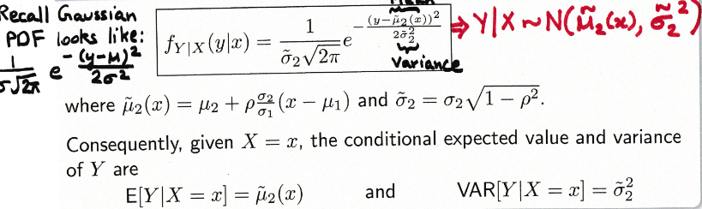
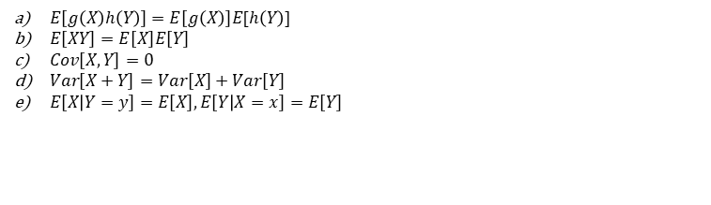
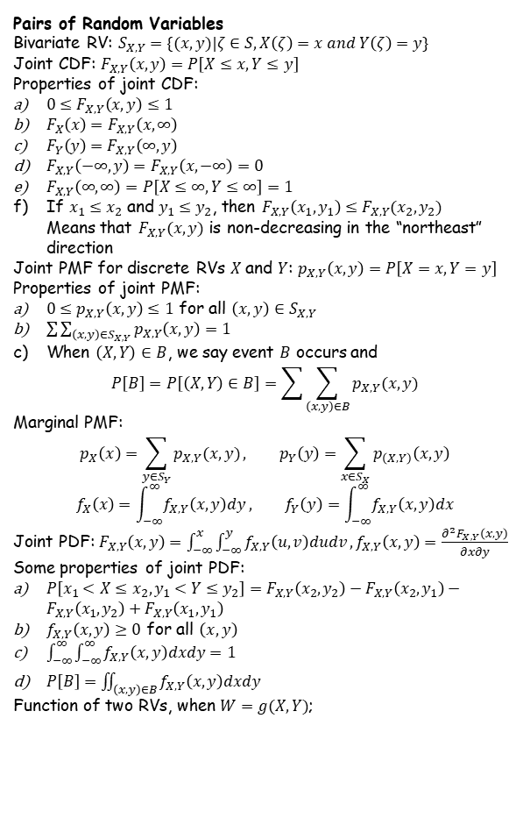
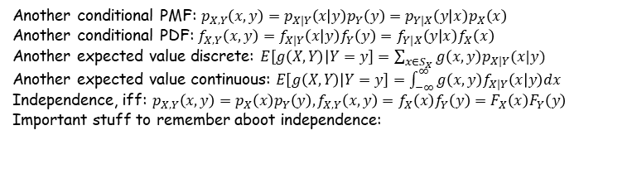
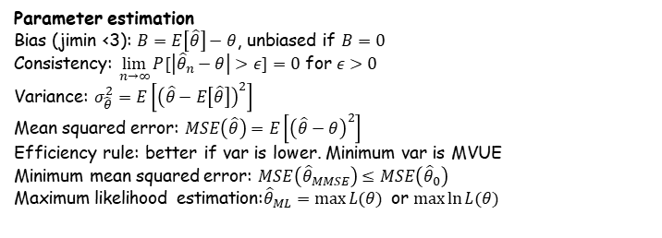
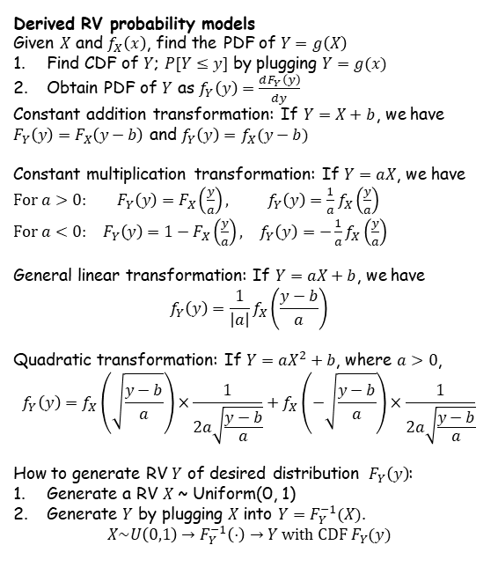
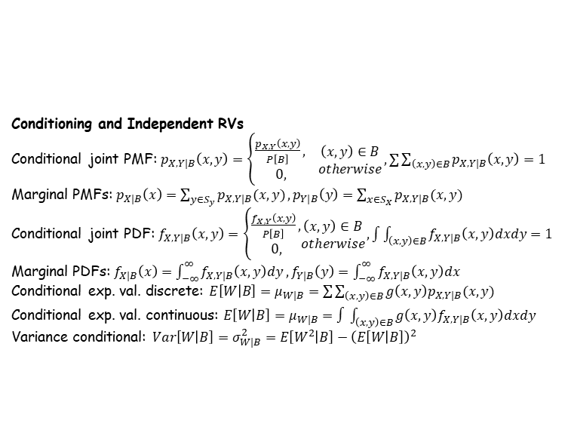
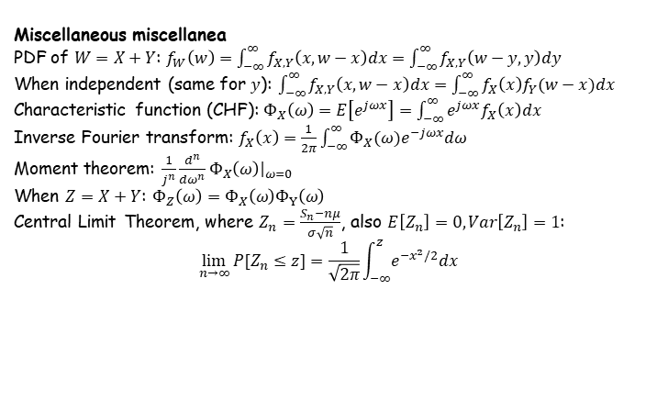
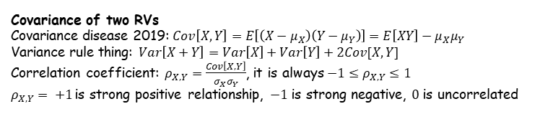
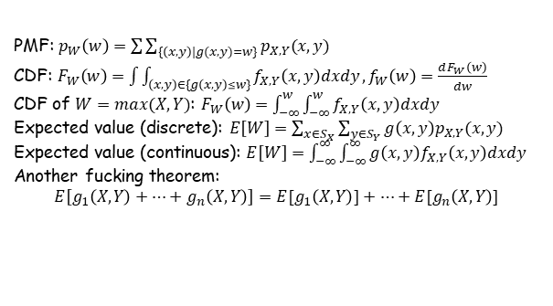

Derived RV probability models
Given $X$ and $f_{X}\left(x\right)$, find the PDF of $Y=g\left(X\right)$
Find CDF of $Y$; $P[Y≤y]$ by plugging $Y=g(x)$
Obtain PDF of $Y$ as $f_{Y}\left(y\right)=\frac{dF_{Y}\left(y\right)}{dy}$
Constant addition transformation: If $Y=X+b$, we have
$F_{Y}\left(y\right)=F_{X}\left(y−b\right)$ and $f_{Y}\left(y\right)=f_{X}(y−b)$
Constant multiplication transformation: If $Y=aX$, we have $\begin{matrix}\text{F}\text{or} a>0: & F_{Y}\left(y\right)=F_{X}\left(\frac{y}{a}\right), & f_{Y}\left(y\right)=\frac{1}{a}f_{X}\left(\frac{y}{a}\right) \\ \text{For} a<0: & F_{Y}\left(y\right)=1−F_{X}\left(\frac{y}{a}\right), & f_{Y}\left(y\right)=−\frac{1}{a}f_{X}\left(\frac{y}{a}\right)\end{matrix}$
General linear transformation: If $Y=aX+b$, we have
$$f_{Y}\left(y\right)=\frac{1}{\left|a\right|}f_{X}\left(\frac{y−b}{a}\right)$$
Quadratic transformation: If $Y=aX^{2}+b$, where $a>0$,
$$f_{Y}\left(y\right)=f_{X}\left(\sqrt{\frac{y−b}{a}}\right)×\frac{1}{2a\sqrt{\frac{y−b}{a}}}+f_{X}\left(−\sqrt{\frac{y−b}{a}}\right)×\frac{1}{2a\sqrt{\frac{y−b}{a}}}$$
How to generate RV $Y$ of desired distribution $F_{Y}\left(y\right)$:
Generate a RV $X$ ~ Uniform(0, 1)
Generate $Y$ by plugging $X$ into $Y=F_{Y}^{−1}(X)$.
$$X\sim U\left(0,1\right)→F_{Y}^{−1}\left(⋅\right)→Y \text{with} \text{CDF} F_{Y}(y)$$
Covariance of two RVs
Covariance disease 2019: $Cov\left[X,Y\right]=E\left[\left(X−μ_{X}\right)\left(Y−μ_{Y}\right)\right]=E\left[XY\right]−μ_{X}μ_{Y}$
Variance rule thing: $Var\left[X+Y\right]=Var\left[X\right]+Var\left[Y\right]+2Cov[X,Y]$
Correlation coefficient: $ρ_{X,Y}=\frac{Cov\left[X,Y\right]}{σ_{X}σ_{Y}}$, it is always $−1≤ρ_{X,Y}≤1$
$ρ_{X,Y}= +1$is strong positive relationship, $−1$ is strong negative, $0$ is uncorrelated
Conditioning and Independent RVs
Conditional joint PMF: $p_{X,Y|B}\left(x,y\right)=\left\{\begin{aligned}\frac{p_{X,Y}\left(x,y\right)}{P\left[B\right]}, \\ &0,\end{aligned} \begin{matrix}\left(x,y\right)∈B \\ otherwise\end{matrix}\right., ∑\sum_{\left(x,y\right)∈B}{p_{X,Y|B}\left(x,y\right)=1}$
Marginal PMFs: $p_{X|B}\left(x\right)=\sum_{y∈S_{y}}{p_{X,Y|B}(x,y)}, p_{Y|B}\left(y\right)=\sum_{x∈S_{X}}{p_{X,Y|B}(x,y)}$
Conditional joint PDF: $f_{X,Y|B}\left(x,y\right)=\left\{\begin{aligned}\frac{f_{X,Y}\left(x,y\right)}{P\left[B\right]}, \\ &0,\end{aligned}\begin{matrix}\left(x,y\right)∈B \\ otherwise\end{matrix}\right., \int{\int_{\left(x,y\right)∈B}{f_{X,Y|B}\left(x,y\right)dxdy=1}}$
Marginal PDFs: $f_{X|B}\left(x\right)=\int_{−∞}^{∞}{f_{X,Y|B}\left(x,y\right)dy},f_{Y|B}\left(y\right)=\int_{−∞}^{∞}{f_{X,Y|B}\left(x,y\right)dx}$
Conditional exp. val. discrete: $E\left[W | B\right]=μ_{W|B}=\sum{\sum_{\left(x,y\right)∈B}{g\left(x,y\right)p_{X,Y|B}(x,y)}}$
Conditional exp. val. continuous: $E\left[W | B\right]=μ_{W|B}=∫\int_{\left(x,y\right)∈B}{g\left(x,y\right)f_{X,Y|B}\left(x,y\right)dxdy}$
Variance conditional: $Var\left[W | B\right]=σ_{W|B}^{2}=E\left[W^{2} | B\right]−{\left(E\left[W | B\right]\right)}^{2}$
Another conditional PMF: $p_{X,Y}\left(x,y\right)=p_{X|Y}\left(x | y\right)p_{Y}\left(y\right)=p_{Y|X}\left(y | x\right)p_{X}\left(x\right)$
Another conditional PDF: $f_{X,Y}\left(x,y\right)=f_{X|Y}\left(x | y\right)f_{Y}\left(y\right)=f_{Y|X}\left(y | x\right)f_{X}\left(x\right)$
Another expected value discrete: $E\left[g\left(X,Y\right) | Y=y\right]=\sum_{x∈S_{X}}{g\left(x,y\right)p_{X|Y}(x|y)}$
Another expected value continuous: $E\left[g\left(X,Y\right) | Y=y\right]=\int_{−∞}^{∞}{g\left(x,y\right)f_{X|Y}\left(x | y\right)dx}$
Independence, iff: $p_{X,Y}\left(x,y\right)=p_{X}\left(x\right)p_{Y}\left(y\right),f_{X,Y}\left(x,y\right)=f_{X}\left(x\right)f_{Y}\left(y\right)=F_{X}\left(x\right)F_{Y}\left(y\right)$
Important stuff to remember aboot independence:
Pairs of Random Variables
Bivariate RV: $S_{X,Y}=\{(x,y)|ζ∈S,X\left(ζ\right)=x and Y\left(ζ\right)=y\}$
Joint CDF: $F_{X,Y}\left(x,y\right)=P\left[X≤x,Y≤y\right]$
Properties of joint CDF:
$0≤F_{X,Y}\left(x,y\right)≤1$
$F_{X}\left(x\right)=F_{X,Y}\left(x,∞\right)$
$F_{Y}\left(y\right)=F_{X,Y}\left(∞,y\right)$
$F_{X,Y}\left(−∞,y\right)=F_{X,Y}\left(x,−∞\right)=0$
$F_{X,Y}\left(∞,∞\right)=P\left[X≤∞,Y≤∞\right]=1$
If $x_{1}≤x_{2}$ and $y_{1}≤y_{2}$, then $F_{X,Y}\left(x_{1},y_{1}\right)≤F_{X,Y}(x_{2},y_{2})$ Means that $F_{X,Y}(x,y)$ is non-decreasing in the “northeast” direction
Joint PMF for discrete RVs $X$ and $Y$: $p_{X,Y}\left(x,y\right)=P\left[X=x,Y=y\right]$
Properties of joint PMF:
$0≤p_{X,Y}\left(x,y\right)≤1$ for all $\left(x,y\right)∈S_{X,Y}$
$\sum{\sum_{\left(x,y\right)∈S_{X,Y}}{p_{X,Y}\left(x,y\right)=1}}$
When $\left(X,Y\right)∈B$, we say event $B$ occurs and
$$P\left[B\right]=P\left[\left(X,Y\right)∈B\right]=\sum{\sum_{\left(x,y\right)∈B}{p_{X,Y}(x,y)}}$$
Marginal PMF:
$$p_{X}\left(x\right)=\sum_{y∈S_{Y}}{p_{X,Y}(x,y)}, p_{Y}\left(y\right)=\sum_{x∈S_{X}}{p_{\left(X,Y\right)}\left(x,y\right)}$$
$$f_{X}\left(x\right)=\int_{−∞}^{∞}{f_{X,Y}\left(x,y\right)dy}, f_{Y}\left(y\right)=\int_{−∞}^{∞}{f_{X,Y}\left(x,y\right)dx}$$
Joint PDF: $F_{X,Y}\left(x,y\right)=\int_{−∞}^{x}{\int_{−∞}^{y}{f_{X,Y}\left(u,v\right)dudv}},f_{X,Y}\left(x,y\right)=\frac{∂^{2}F_{X,Y}\left(x,y\right)}{∂x∂y}$
Some properties of joint PDF:
$P\left[x_{1}<X≤x_{2}, y_{1}<Y≤y_{2}\right]=F_{X,Y}\left(x_{2},y_{2}\right)−F_{X,Y}\left(x_{2},y_{1}\right)−F_{X,Y}\left(x_{1},y_{2}\right)+F_{X,Y}\left(x_{1},y_{1}\right)$
$f_{X,Y}\left(x,y\right)≥0$ for all $\left(x,y\right)$
$\int_{−∞}^{∞}{\int_{−∞}^{∞}{f_{X,Y}\left(x,y\right)dxdy}=1}$
$P\left[B\right]=\iint_{\left(x,y\right)∈B}{f_{X,Y}\left(x,y\right)dxdy}$
Function of two RVs, when $W=g(X,Y)$;
$E\left[g\left(X\right)h\left(Y\right)\right]=E\left[g\left(X\right)\right]E[h\left(Y\right)]$
$E\left[XY\right]=E\left[X\right]E\left[Y\right]$
$Cov\left[X,Y\right]=0$
$Var\left[X+Y\right]=Var\left[X\right]+Var\left[Y\right]$
$E\left[X | Y=y\right]=E\left[X\right], E\left[Y | X=x\right]=E\left[Y\right]$
Note: iff = if and only if
Bivariate Gaussian shit
Bivariate standard Gaussian: $f_{X,Y}\left(x,y\right)=\frac{1}{2π\sqrt{1−ρ^{2}}}e^{−(x^{2}−2ρxy+y^{2})/[2\left(1−ρ^{2}\right)]}$
Marginal PDFs: $f_{X}\left(x\right)=\frac{1}{\sqrt{2π}}e^{−\frac{x^{2}}{2}}, f_{Y}\left(y\right)=\frac{1}{\sqrt{2π}}e^{−\frac{y^{2}}{2}}$
General bivariate gaussian RVs:
$$f_{X,Y}\left(x,y\right)=\frac{exp\left\{−\frac{1}{2\left(1−ρ^{2}\right)}\left[{\left(\frac{x−μ_{1}}{σ_{1}}\right)}^{2}−\frac{2ρ\left(x−μ_{1}\right)\left(y−μ_{2}\right)}{σ_{1}σ_{2}}+{\left(\frac{y−μ_{2}}{σ_{2}}\right)}^{2}\right]\right\}}{2πσ_{1}σ_{2}\sqrt{1−p^{2}}} _{ }$$
Conditional (You can switch around X and Y. This shit is getting ridiculous):
Bivariate Gaussian RVs are uncorrelated iff X and Y are independent
Miscellaneous miscellanea
PDF of $W=X+Y$: $f_{W}\left(w\right)=\int_{−∞}^{∞}{f_{X,Y}\left(x,w−x\right)dx}=\int_{−∞}^{∞}{f_{X,Y}\left(w−y,y\right)dy}$
When independent (same for $y$): $\int_{−∞}^{∞}{f_{X,Y}\left(x,w−x\right)dx}=\int_{−∞}^{∞}{f_{X}\left(x\right)f_{Y}(w−x)dx}$
Characteristic function (CHF): $Φ_{X}\left(ω\right)=E\left[e^{jωx}\right]=\int_{−∞}^{∞}{e^{jωx}f_{X}\left(x\right)dx}$
Inverse Fourier transform: $f_{X}\left(x\right)=\frac{1}{2π}\int_{−∞}^{∞}{{Φ_{X}(ω)e}^{−jωx}dω}$
Moment theorem: $\frac{1}{j^{n}}\frac{d^{n}}{dω^{n}}Φ_{X}\left(ω\right){\left.​\right|}_{ω=0}$
When $Z=X+Y$: $Φ_{Z}\left(ω\right)=Φ_{X}\left(ω\right)Φ_{Y}\left(ω\right)$
Central Limit Theorem, where $Z_{n}=\frac{S_{n}−nμ}{σ\sqrt{n}}$, also $E\left[Z_{n}\right]=0, Var\left[Z_{n}\right]=1$:
$$\lim_{n→∞}{P[Z_{n}≤z]}=\frac{1}{\sqrt{2π}}\int_{−∞}^{z}{e^{−x^{2}/2}dx}$$
PMF: $p_{W}\left(w\right)=\sum{\sum_{\{\left(x,y\right)|g(x,y)=w\}}{p_{X,Y}(x,y)}}$
CDF: $F_{W}\left(w\right)=\int{\int_{\left(x,y\right)∈\{g\left(x,y\right)≤w\}}{f_{X,Y}\left(x,y\right)dxdy}}, f_{W}\left(w\right)=\frac{dF_{W}\left(w\right)}{dw}$
CDF of $W=max(X,Y)$: $F_{W}\left(w\right)=\int_{−∞}^{w}{\int_{−∞}^{w}{f_{X,Y}\left(x,y\right)dxdy}}$
Expected value (discrete): $E\left[W\right]=\sum_{x∈S_{X}}{\sum_{y∈S_{Y}}{g\left(x,y\right)p_{X,Y}(x,y)}}$
Expected value (continuous): $E\left[W\right]=\int_{−∞}^{∞}{\int_{−∞}^{∞}{g\left(x,y\right)f_{X,Y}\left(x,y\right)dxdy }}$
Another fucking theorem:
$$E\left[g_{1}\left(X,Y\right)+…+g_{n}\left(X,Y\right)\right]=E[g_{1}\left(X,Y\right)]+…+E[g_{n}\left(X,Y\right)]$$
Parameter estimation
Bias (jimin <3): $B=E\left[\hat{θ}\right]−θ$, unbiased if $B=0$
Consistency: $\lim_{n→∞}{P[\left|{\hat{θ}}_{n}−θ\right|>ε]}=0$ for $ε>0$
Variance: $σ_{\hat{θ}}^{2}=E\left[{\left(\hat{θ}−E\left[\hat{θ}\right]\right)}^{2}\right]$
Mean squared error: $MSE\left(\hat{θ}\right)=E\left[{\left(\hat{θ}−θ\right)}^{2}\right]$
Efficiency rule: better if var is lower. Minimum var is MVUE
Minimum mean squared error: $MSE\left({\hat{θ}}_{MMSE}\right)≤MSE\left({\hat{θ}}_{0}\right)$
Maximum likelihood estimation:${\hat{θ}}_{ML}=\max{L(θ)}$ or $\max{\ln{L(θ)}}$

